Slide 1


Graduate Training in
Clinical Psychology
What is clinical psychology?
What type of experience do I need?
How do I apply?
Funding your graduate education
Ask us!

Slide 2


What is clinical psychology?
Roles of a psychologist
Where do psychologists work?
Overview of clinical psychology programs
Other mental health graduate programs

Slide 3
Roles of a psychologist
Assessment and diagnosis
  Psychodiagnostic testing
  Psychoeducational evaluations
  Neuropsychological assessments
Provision of therapy
  Individual (adult, child)
  Couples and families
  Groups
Clinical research
Consultation
Education

Slide 4
Where do psychologists work?
Government agencies
Veterans’ and military hospitals
Drug rehabilitation and correctional facilities
Elementary and secondary schools
Colleges and universities
Hospital and medical clinics
Mental health hospitals and community centers
Group and private practices

Slide 5
Overview OF CLINICAL PSYCHOLOGY PROGRAMS
Training models
  Clinical scientist
  Scientist-practitioner
  Practitioner-scholar
Specialties/concentrations
  Clinical child/adolescent psychology
  Clinical adult psychology
  Clinical health psychology
  Combinations – ex. clinical child & health = pediatric psychology
  Neuropsychology (child, adult, or lifespan)

Slide 6
Other mental health graduate programs
Clinically-focused degrees
  Social work (typically M.S.W.)
  School psychology (terminal Master’s or Ph.D.)
  Licensed professional counselor (LPC) & Marriage and family therapist (MFT)
  Doctorate in Psychology (Psy.D.)
Research-focused degrees
  Master’s in general psychology
  Counseling psychology Ph.D.
  School psychology Ph.D.
Medical degree
  Psychiatry (M.D.)

Slide 7
What type of experience do I need?
Undergraduate Research Experience
  Lab assistant
  Independent project
Post-Baccalaureate Experience
  Research
  Clinical

Slide 8
Post-Baccalaureate opportunities
Paid or volunteer research positions
Terminal Master’s programs
Some (limited) bachelor’s-level clinical positions
Why?
Difficult to gain acceptance to clinical Ph.D. program directly post-bac
Gain skills and prepare for transition to graduate work
Time to refine your interests
Be sure that this is what you want to do!

Slide 9
How do I apply?
RESEARCH different programs
TAKE THE GRE (General and Psychology)
GET Letters of Recommendation
Write a personal statement
Prepare your CURRICULUM VITAE (CV)

Slide 10
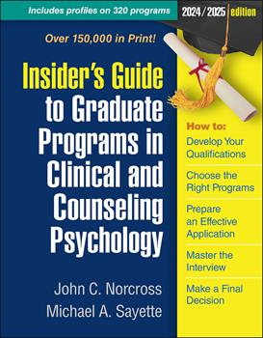
Research different programs
Take time to really research programs
  Identify possible major professors
    All about FIT
  APA accreditation

Slide 11



Take the GRE (General and Psychology)
General GRE offered throughout the year
Psych GRE offered only on specific dates
* Many schools no longer require the GRE

Slide 12
Obtain letters of recommendation
Submit three letters
Try to have at least one writer with a Clinical Psychology PhD
Most impressive letters say more than how well you did in a class
Ask for letters EARLY
Give letter writers your CV, personal statement, list of programs, and deadlines
Be appreciative and nice ☺

Slide 13
Write your personal statement(s)
Tailor your statement to each program and professor
Describe:
  Your research interests – identify research mentors
  Your fit – with a faculty mentor and the training model
  Highlight your strengths and your achievements
  Be careful about any personal information you share

Slide 14
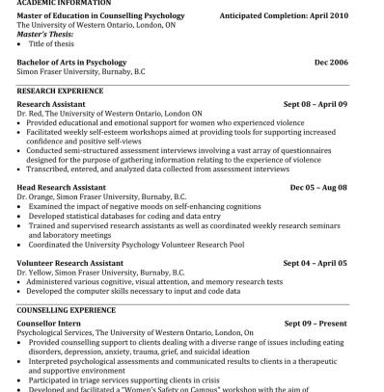
Prepare a Curriculum Vitae (CV)
CV = academic resume
  Contact information
  Educational background
  Awards/honors
  Presentations
  Publications
  Research experience
  Clinical experience
  Other work experience
  Specific academic skills
  Professional memberships
  Leadership roles

Slide 15
Funding your graduate education
Varies:
  Master’s Degree- clinically focused (primarily self funded, loans, limited fellowships)
  Master’s Degree- research focused (primarily self funded, loans, limited fellowships)
  PsyD- (primarily self funded, some programs offer stipends)
  PhD- clinically focused (most offer at least partial stipends, some offer additional support)
  PhD- research focused (primarily university funded, additional support)

Slide 16
Funding Opportunities
Research Assistantships / Training Grants
Teaching Assistantships
University Fellowships
External Fellowships

Slide 17
APA Minority Fellowship Program
Predoctoral Fellowship (3 years of support)
Mentoring, travel support, training opportunities, internship application support, potential dissertation support
Postdoctoral Fellowship (2 years of support)
Mentoring, travel support, training opportunities, access to information and resources

Slide 18
SREB DOCTORAL SCHOLARS
$20,000 stipend for 3 years
Additional support from the university for 2 years
Tuition expenses
Conference travel

Slide 19
More resources about funding and OTHER opportunities:
APA Grants, Awards, and Funding Page
  https://www.apa.org/about/awards
NIH Fellowships and Training Page
  Summer Internship Program (SIP)
  Student Intramural Research and Training Award (IRTA)
Post-Bacc Opportunities:
  University of Pittsburgh Hot Metal Bridge Program
    https://www.asgraduate.pitt.edu/hot-metal-bridge-post-bac-program
  https://undergrad.psychology.fas.harvard.edu/post-graduate-research-jobs
  Twitter (Research Coordinator ads)
  APA List Serv

Slide 20
Ask Us!
PATHS TO GRADUATE SCHOOL
Experiences as an undergrad/postbac
Deciding to go to graduate school
EXPERIENCES AS A GRADUATE STUDENT
Negotiating identity
Balancing multiple roles: Student; researcher; clinician-in-training; teacher; other roles
Challenges (and good things) about getting a Ph.D.
OTHER QUESTIONS YOU HAVE!

